Slide 1
Vabatahtlik töö ja sport

Slide 2
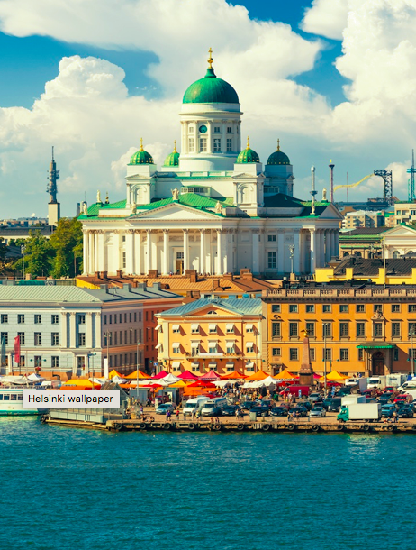
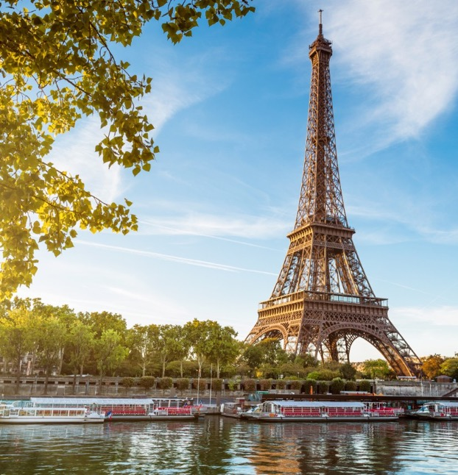
VABATAHTLIK TÖÖ EUROOPAS
STATUS QUO 2017
Notes:
Does any of you currently volunteer?If so, why do you volunteer?

Slide 3
HETKESEIS
Notes:
This slide mainly serves to build up a little bit of drama, to raise awareness for the following stats and the issue that only 6 % in Europe volunteer.
Current status is dark: only 6 % (2013 it was 7%)

Slide 4
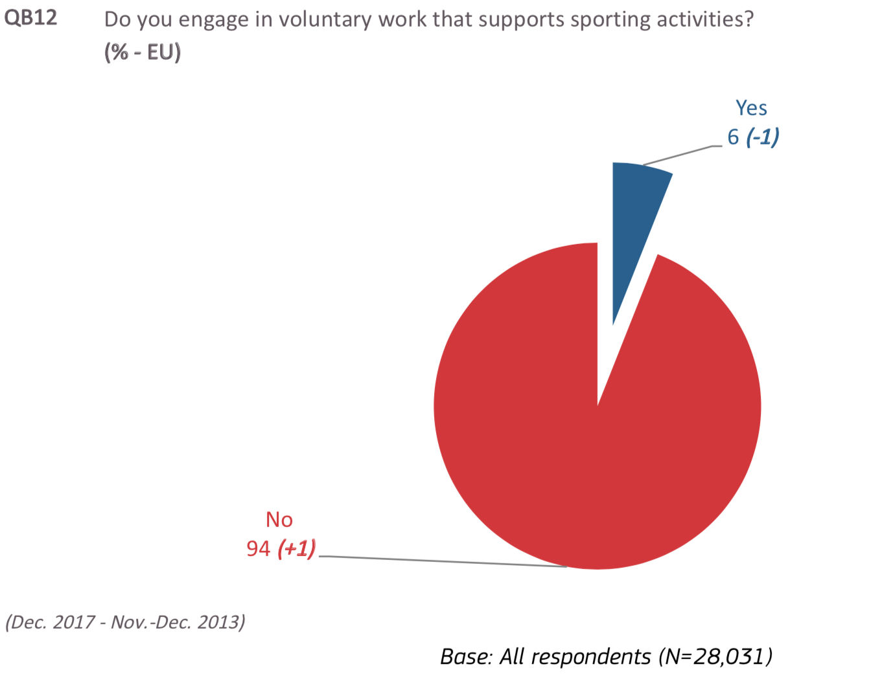
MITU % TEEB EUROOPAS VABATAHTLIKU TÖÖD?

Slide 5
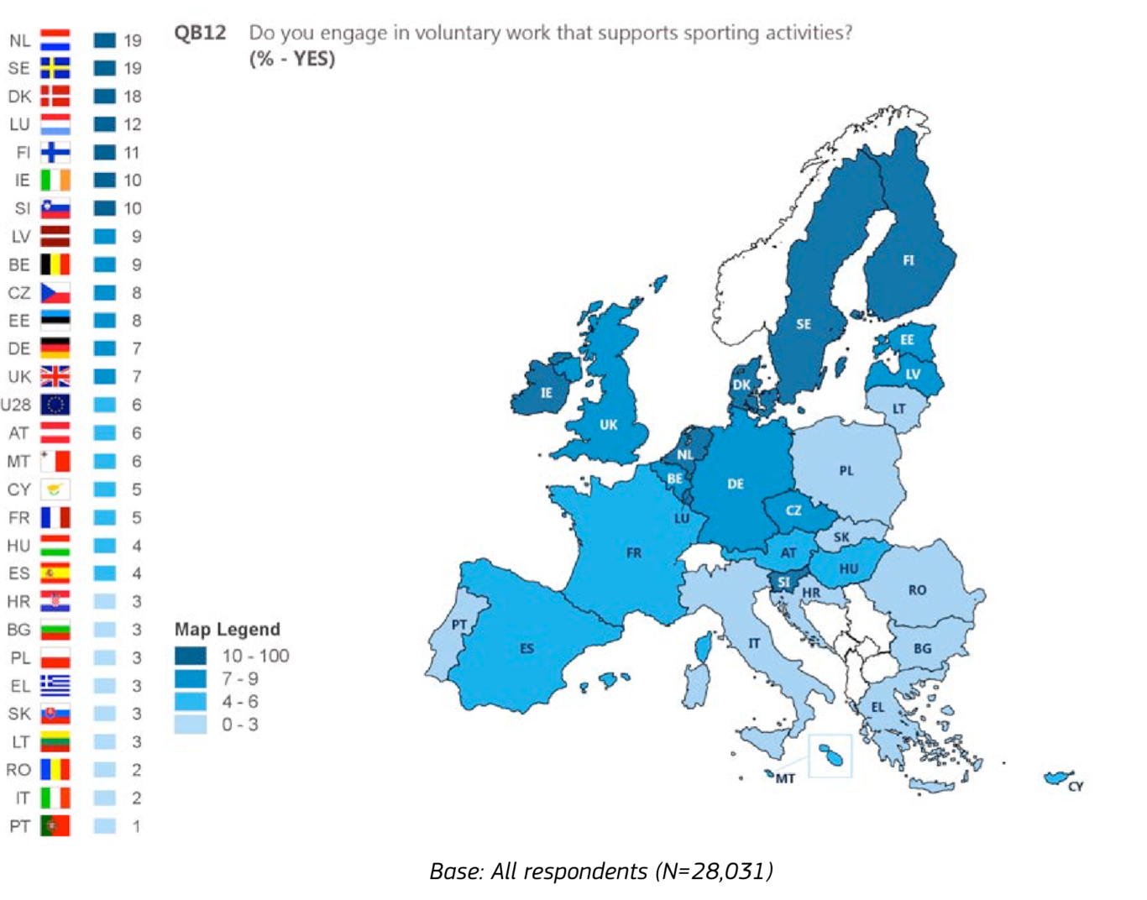
ERINEV
PILT EUROOPAS

Slide 6
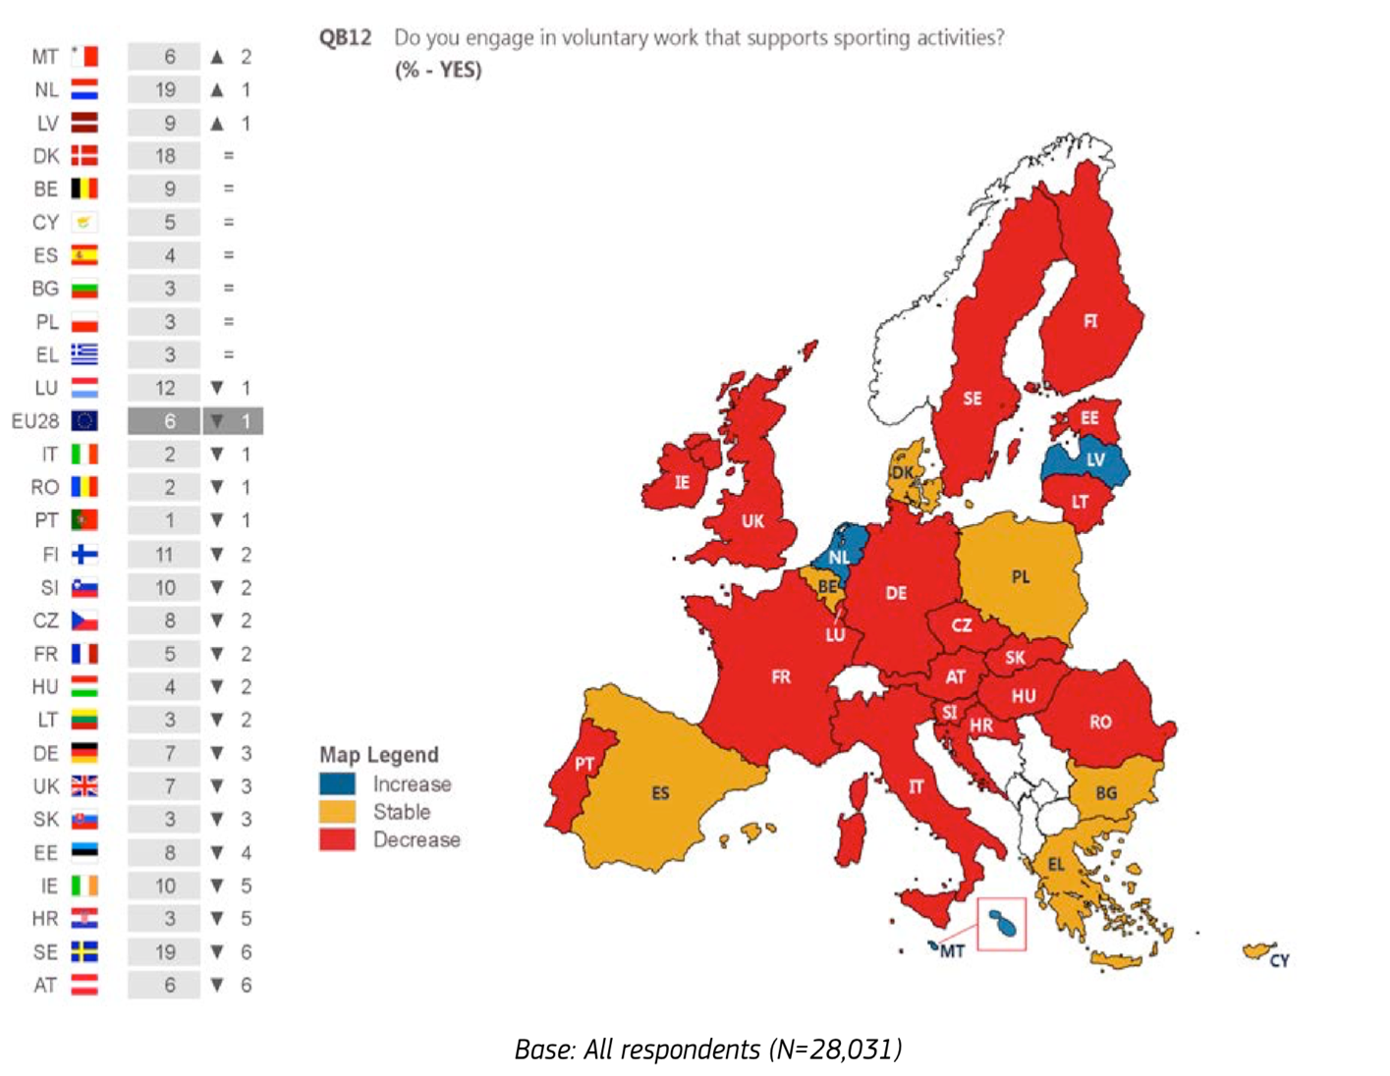
MIS ON SUUND?

Slide 7
KES TEEB KÕIGE TÕENÄOLISEMALT VABATAHTLIKU TÖÖD?
8%
12%
Regulaarne treening
11%
Mingi regulaarsus
4%
4%
Harva
2%
Mitte kunagi
Notes:
8% of men say they volunteer, compared with 4% of women.
12% of people who exercise or play sport regularly and 11% of those who do so with some regularity volunteer in sport, compared with 4% of people who seldom do so and 2% of those who never exercise or play sport.

Slide 8
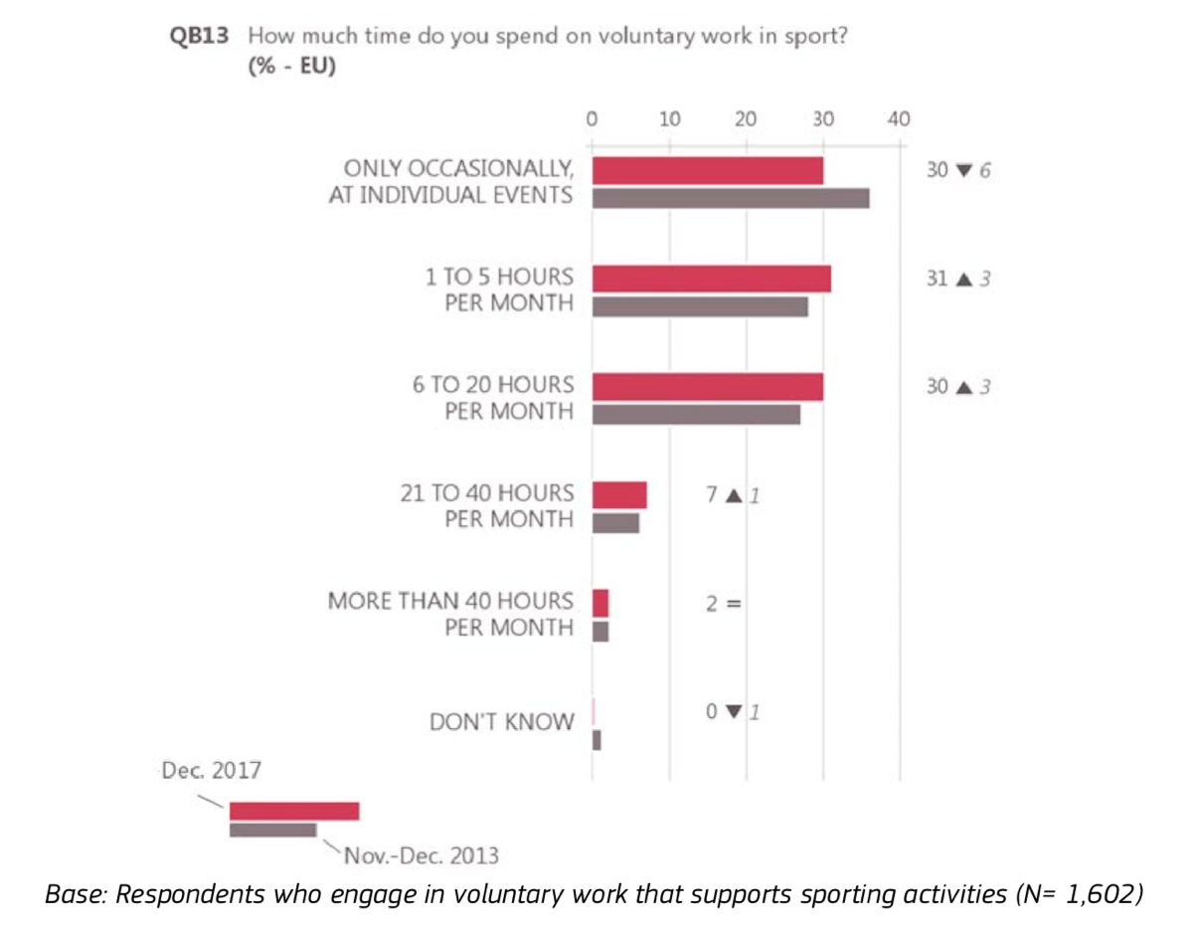
KESKMINE VABATAHTLIKU TÖÖ KESTVUS

Slide 9
Definitsioonid?
https://www.bbc.co.uk/sport/get-inspired/28427094
https://doit.life/join-in

Slide 10
Vabatahtlik töö tänapäeval?
Inglismaal kulutavad vähemalt ühe tunni nädalas vabatahtlikule tööle spordis 3 miljonit täiskasvanut (3,078,900) – see võrdub 7.3% täiskasvanute populatsioonist. Reference: Sport England (2011) Active People Survey, 5 London, Sport England
Osalemine formaalses vabatahtlikus töös (tasustamata abistamine läbi klubi või mõne muu organiseeritud mooduse) on aeglaselt ajapikku vähenemas. Aastal 2005, 29% inimestest Inglismaal tegid formaalset vabatahtliku tööd vähemalt ühe korra kuus, 2010/2011 oli see number 25%. Reference: Department for Communities and Local Government (2011) Citizenship Survey
Inglismaa spordivabatahtlike majanduslik väärtus on hinnatud natuke alla £2 miljardi aastas – see on summa, mida oleks vaja, et palgata täiskohaga töötajad tegema seda tööd, mida spordivabathatlikud teevad, põhineb see mediaan tunnipalgale. Reference: Based on calculations from data within NCVO (2010) The UK Civil Society Almanac 2010
Notes:
Volunteering is significant in sustaining the operations of sport organizations. Recent data reveal that it would cost sport organizations approximately 2 billion pounds per year to employ full-time workers to carry out the activities undertaken by volunteers.7.3% of the adult population in England (3 million adults) undertake a volunteer activity for at least an hour per week.This is significant, if you think of the skills, knowledge and social capital that is developed when individuals are brought together under a common purpose as well as why governments rely heavily on the voluntary sector to reduce the costs associated with correcting market failure.However recent research suggests that volunteering is in decline over time. In 2005, 29% of the adult population in England formally volunteered in sport, while this figure has been reduced to 25& in 2010/2011.
Research further suggests that sport would become far less accessible without inputs from volunteers, as Member States would either have to substantially increase their financial contributions or organisations would have to increase their membership fees to a level which a large share of the population would not be able to afford. In the majority of countries, the average number of hours dedicated to volunteering in sport per week revolves around 4-5 hours.

Slide 11
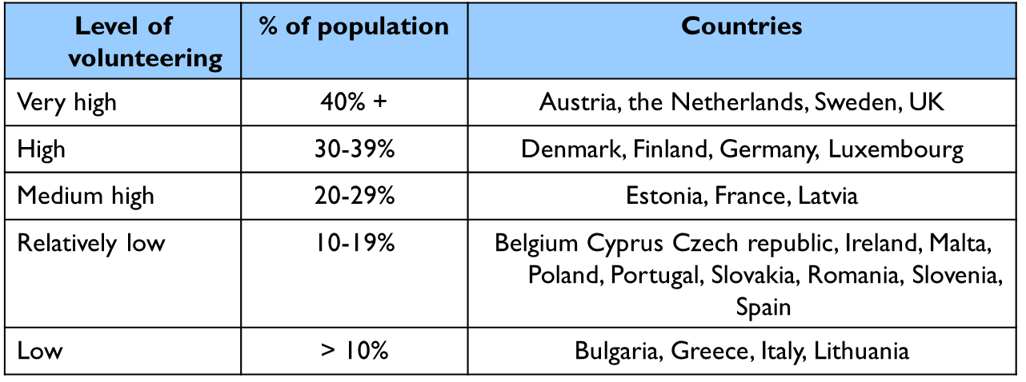
Teiste riikide vabatahtliku töö suurus?
5.3milj. Kanadalast teeb spordis vabatahtliku tööd (28% kogu vabatahtlikust tööst) ja panustavad 0.4 miljardit tundi aastas; 1.7milj. Austraallast teeb vabatahtlikku tööd
Palgalise tööjõu ja vabatahtliku töö suhe
Austria - 14% palgaline tööjõud ja 86% vabatahtlikke
Prantsusmaa - peaaegu 80% vabatahtlikke
Portugal - 90% vabatahtlikke
Holland - 13% palgaline tööjõud ja 87% vabatahtlikke VS
Iirimaa ja Eesti 42% palgaliste tööjõudu, 68% vabatahtlikke
Saksamaa kõrgem jaotus - palgaline tööjõud võrreldes
vabatahtlikega (69.7% vs. 30.3%)
Spordivabatahtlike panus on võrreldav:
42,000 täis-ajaga samaväärset töökohta Taanis
210,000 Saksamaal
30,590 Soomes
271,000 Prantsusmaal
178,500 Kanadas
106,000 Ühendkuningriigis
Vabatahtlike arv 1000 elaniku kohta:
Soome 60
Rootsi ja Taani >50
Saksamaa >40
Prantsusmaa ja Inglismaa 26
Notes:
in the majority of countries the sport sector appears to rely heavily on volunteers; the proportion of paid staff and volunteers varies between being relatively small (e.g. Ireland 42% paid staff and 58% volunteers,Estonia 43% paid staff and 57% volunteers) to being significant (e.g. Austria 14% paid staff and 86% volunteers; France almost 80% volunteers; the Netherlands 13% paid staff and 87% volunteers; Portugal 90% volunteers). This trend can partly be explained by the fact that in most countries, sport organisations and federations are non-profit entities.It is interesting to note however, that Germany is the only country where the share of paid staff (69.7%) is higher than the share of volunteers (30.3%). This trend could be a consequence of the fact that the majority of volunteers in German sport associations are found at managerial level (12.7% volunteers and 0.3% paid staff) and the share of volunteers then decreases with the level of responsibilities. Similarly, because volunteer contribution in Latvia is event-based, sport federations and associations donot have high numbers of volunteers within their staffResearch further suggests that sport would become far less accessible without inputs from volunteers, as Member States would either have to substantially increase their financial contributions or organisations would have to increase their membership fees to a level which a large share of the population would not be able to afford. In the majority of countries, the average number of hours dedicated to volunteering in sport per week revolves around 4-5 hours.
Volunteering levels across different countries reflects sports participation. Those countries keen to participate more in sports have a stronger volunteering culture Reliance on volunteers across European sports clubs:
Austria - 14% paid staff and 86% volunteers
France - almost 80% volunteers
Netherlands - 13% paid staff and 87% volunteers
Volunteering is significant in sustaining the operations of sport organizations. Recent data reveal that it would cost sport organizations approximately 2 billion pounds per year to employ full-time workers to carry out the activities undertaken by volunteers.7.3% f the adult population in England (3 million adults) undertake a volunteer activity for at least an hour per week.This is significant, if you think of the skills, knowledge and social capital that is developed when individuals are brought togeher under a common purpose as well as why governments rely heavily on the voluntary sector to reduce the costs associated with correcting market failure.However recent research suggests that volunteering is in decline over time. In 2005, 29% of the adult population in England formally volunteered in sport, while this figure has been reduced to 25& in 2010/2011
Overall however, there has
been a general upward trend in the number of volunteers active in the EU in the last ten years (see Table 3.4). Ten countries have seen an increase in the number of
volunteers over the past decade
Gender - In many countries a gender dimension is more apparent in specific sectors (e.g. sport, health, social and rescue services) and voluntary roles (e.g. managerialand operational roles) rather than in overall participation rates in volunteering). In many countries the dominance of male volunteers can be explained by the fact the sport sector attracts the highest number of volunteers and more men than women tend to volunteer in sport. Sweden and the Netherlands are the only countries, which feature very high level of volunteering in national studies, as well as in the Eurobarometer andEuropean Values Study. In many countries the dominance of male volunteers can be explained by the fact the sport sector attracts the highest number of volunteers and more men than women
tend to volunteer in sport. For example, in Denmark there are important statistical variances between the participation of men and women in different areas of the voluntary sector. Men are considerably more involved in sport clubs and local community activities compared to women. At the same time women are significantlymore involved in health and social service related work than men. Likewise in Finland, 19% of adult men volunteer in sport in comparison to 13% of women.
􀂃 Other countries, which have consistently been identified as having either high or very high levels of participation in volunteering are Denmark, Finland and Luxembourg.
􀂃 Other countries with relatively high levels of volunteering are Austria, the UK and Slovakia.
􀂃 In contrast, countries, which have consistently been identified by national reports and the Eurobarometer and European Value surveys as having low or relatively low levels of participation in volunteering, are Bulgaria, Lithuania, Poland, Portugal, Romania and Spain.
Our European experts confirmed the lack of a “culture of volunteering” in parts of Eastern Europe, emerging from a centralised economy

Slide 12
Rahastuse allikad?
Liikmemaksud (Soome, Prantsusmaa, Saksamaa, Holland, Hispaania);
Toetajate otsimine ja annetused (Eesti, Sloveenia, Hispaania);
Sponsorlused (Sloveenia);
Avalik rahastus – riik (Küpros, Prantsusmaa, Portugal);
Avalik rahastus – maakondlikud ja kohalikud omavalitsused (Eesti);
Muu sissetulek (nt. spordiürituste piletite müük, baari ja restorani tulud jne.): Rumeenia, Hispaania.
Notes:
Sources of fundingRegarding the sport sector, there are important differences in the sources of fundingavailable to sport organisations. For Member States5 where such information was available, sport organisations mainly rely on:
􀂃 Membership fees (Finland, France, Germany, the Netherlands, Spain);
􀂃 Fundraising and donations (Estonia, Slovenia, Spain);
􀂃 Sponsorship (Slovenia);
􀂃 Public funding – state (Cyprus, France, Portugal);
􀂃 Public funding – regional and local authorities (Estonia);
􀂃 Other income (e.g. sales of tickets to sport events organised, bar and restaurantservices, etc): Romania, Spain.
Research further suggests that sport would become far less accessible without inputs from volunteers, as Member States would either have to substantially increase their financial contributions or organisations would have to increase their membership fees to a level which a large share of the population would not be able to afford. In the majority of countries, the average number of hours dedicated to volunteering in sport per week revolves around 4-5 hours.

Slide 13
Vabatahtliku töö maastik EL-is
23% või umbes 94 miljonit täiskasvanut Euroopa Liidus on seotud vabatahtliku tööga.
Vanus – Paljudes EL-i riikides leidub kõige rohkem vabatahtlike 30a.-50a. hulgas.
Sugu - Spordi valdkonnas osaleb rohkem mehi kui naisi vabatahtlikus töös.
Haridustase – Riiklikud raportid on väga hästi illustreerinud, et on selge ja positiivne seos haridustaseme ja vabatahtliku töö tegemise soodumuse vahel.
Töökoha staatus – Enamuses EL-i riikides on kõige aktiivsemad vabatahtlikud just töötavad inimesed.
Sektorid – Üle poolte EL-i riikidest on kõige rohkem vabatahtlikke spordi sektoris. Spordivabatahtlikud esindavad suurt osa kõikidest vabatahtlikes Taanis (31.5%), Prantsusmaal (25%) and Maltal (84%). Liikmesriikide hulgas kõige aktiivsem vabatahtlik tegevuses on jalgpallis. Lisaks spordile on vabatahtlikud veel aktiivsed järgmistes sektorites:
Sotsiaalsektor, heaolu ja tervise tegevustes;
Religioossed organisatsioonid;
Kultuur;
Rekreatsioon ja vaba aeg; ja
Haridus, koolitused ja uuringud.
Notes:
An analysis of the national surveys and reports on volunteering identified by key stakeholders in the Member States indicates that, there are around 92 to 94 million
adults involved in volunteering in the EU. This in turn implies that around 22% to 23% of Europeans aged over 15 years are engaged in voluntary work. The national
surveys tend to show lower levels of volunteering in comparison to some of the key European or international surveys2.
Regarding volunteers in sport, the data gathered indicates that volunteering in sport represents a significant share of the adult population in Finland (16%), Ireland(15%), the Netherlands (12-14%), Denmark (11%), Germany (10.9%) and Malta (9.2%). Conversely, in Estonia (1.1%), Greece (0.5%), Lithuania (0.1%), Latvia and Romania (less than 0.1%) volunteering in sport does not appear to be a common practice. growing numbers of volunteers needed to support the delivery of public services; increasing number of individuals involved in project based or short-term volunteering as opposed to long-term volunteering; increased involvement of older people and the change in public perceptions, particularly in the New Member States.
Gender - In many countries a gender dimension is more apparent in specific sectors (e.g. sport, health, social and rescue services) and voluntary roles (e.g. managerial
and operational roles) rather than in overall participation rates in volunteering. However, in general, most countries tend to have either a greater number of male
volunteers than female (11 countries) or an equal participation between men andwomen (9 countries). In many countries the dominance of male volunteers can be explained by the fact the sport sector attracts the highest number of volunteers and more men than women tend to volunteer in sport. Sweden and the Netherlands are the only countries, which feature very high level of volunteering in national studies, as well as in the Eurobarometer andEuropean Values Study. For example, in Denmark there are important statistical variances between the participation of men and women in different areas of the
voluntary sector. Men are considerably more involved in sport clubs and local community activities compared to women. At the same time women are significantly
more involved in health and social service related work than men. Likewise in Finland, 19% of adult men volunteer in sport in comparison to 13% of women. In the
Netherlands, men are most frequently active in sport clubs, churches and mosques, while women tend to opt for voluntary work in schools or in welfare services. Men also dominate sectors such as volunteering in rescue services, for example, in Estonia, Finland and the Netherlands.

Slide 14
Mida vabatahtlikud teevad?
Rahade kogumine/ rahadega tegelemine
Organiseerimine, ürituste läbiviimisel abistamine
Komitee või juhatuse liige
Treeneriks olemine
Tseremooniate läbiviimine
punktide näitaja/aja mõõtja
esmaabi/ meditsiinilised teenused
http://www.youtube.com/watch?v=2pSqAQLG-ic
Notes:
Volunteers perform a variety of duties ranging from coaching, maintaining grounds, and providing transportation through to senior management and development roles such as chairpersons, club secretaries, and treasurers. Younger volunteers were much more likely than older ones to coach***
Older volunteers tended to take on administrative roles***
According to information from these countries, the most commonly reported main activities carried out by volunteers are:
􀂃 Administrative and supporting tasks;􀂃 Helping or working directly with people;􀂃 Preparing and supporting voluntary activities;􀂃 Managerial and coordination tasks;􀂃 Campaigning and lobbying; and􀂃 The organisation of events.
In addition to the differences in main voluntary activities, an analysis of the nationalreports on volunteering also highlights a number of differences between different
segments of volunteers:
􀂃 In certain countries there appear to be differences between the types ofactivities carried out by men and women. In the Netherlands, although there is an overall equal gender distribution in the profile of volunteers, women tend to be more present in operational roles and men more in the managerial positions within volunteering. In Denmark,gender based differences appear in the areas of committee work and training where fewer women than men are involved. In the UK, women are considerabl ymore likely than men to volunteer in education.
􀂃 A survey conducted on behalf of the Austrian Federal Ministry of Labour, Social Affairs and Consumer Protection suggested a link between the employment
status of a person in paid work, their level of education and the type of voluntary activity undertaken (‘leading’ versus ‘technical’ ). According to the report, only
18% of workers and around 19% of those not employed (unemployed, housewives, etc.) were occupying a managerial role while volunteering. Incontrast, almost 40% of executives and 42% of self-employed individuals took on leading roles in their voluntary activities.
􀂃 A number of countries have noted that a volunteer’s level of education can influence the types of voluntary activities they carry out. For example, in Denmark individuals with higher levels of education are the most involved in all types of activities. This is particularly noticeable in ‘committee work’, in which
29% of highly educated volunteers take part, in contrast to only 9% of individuals with no education. This difference is only minimal when it comes to practical activities; 17% of highly educated volunteers and 15% of those with no education carry out these tasks. Likewise in Austria, only 11% of individuals with little or no formal education (i.e. completed or uncompleted compulsory education) undertake leadership roles as volunteers. In contrast, 37% of individuals with a university degree occupy leadership positions. In short, in Austria, the higher educated an individual is, the more likely they are to occupy a ‘leading’ or managerial role in their voluntary activities.􀂃 In certain countries there appear to be differences between the activities undertaken by volunteers from different age groups. In Denmark for example, volunteers aged between 30-49 years have the highest level of involvement in all activity types, whereas young people only have comparable levels of input into training and fundraising, and the elderly having significantly less involvement with all types of activities. In Finland, a growing number of young people tend to want tailored voluntary positions, which relate to their own interests, wishes and aspirations, and they prefer ‘real’ activity to administrative duties.
􀂃 Another trend is that it is increasingly common for volunteers to undertake more than one type of activity – for example, in the UK most volunteers undertookmore than one type of volunteering activity (either in one or more organisations). Indeed, over one-quarter (27%) of volunteers had been involved in five or more different formal volunteering activities over the past 12 months.
􀂃 Furthermore, several countries have distinguished geographical differences within their territories in relation to voluntary activities. In Latvia, for example, the
number of volunteers undertaking certain activities in NGOs varies between Riga and other regions in the country – in general, volunteers in Riga are less
involved in the organisation of campaigns and events, the implementation of project activities, daily office work, and participate less on organisation boards
than volunteers in other regions of Latvia. Similarly, in the UK there are differences in the types of activities carried out by volunteers in England, Scotland and Northern Ireland. For example, survey findings indicate that volunteers in England are much more likely to participate in the organisation of events than those in Scotland. In Northern Ireland, the most common activity undertaken by volunteers was ‘raising or handling money’; in England ‘helping toraise money’ was also the most common activity, but was carried out by a significantly higher proportion of volunteers

Slide 15
Vabatahtlikus spordis
Notes:
Only slightly more men than women are employed in sport or engaged in volunteer work supporting sport activities. • … But their roles tend to be different
- In many countries a gender dimension is more apparent in specific sectors (e.g. sport, health, social and rescue services) and voluntary roles (e.g. managerial
and operational roles) rather than in overall participation rates in volunteering. However, in general, most countries tend to have either a greater number of male
volunteers than female (11 countries) or an equal participation between men andwomen (9 countries). In many countries the dominance of male volunteers can be explained by the fact the sport sector attracts the highest number of volunteers and more men than women tend to volunteer in sport.
In certain countries there appear to be differences between the types ofactivities carried out by men and women. In the Netherlands, although there is an overall equal gender distribution in the profile of volunteers, women tend to be more present in operational roles and men more in the managerial positions within volunteering. In Denmark,gender based differences appear in the areas of committee work and training where fewer women than men are involved. In the UK, women are considerabl ymore likely than men to volunteer in education.

Slide 16
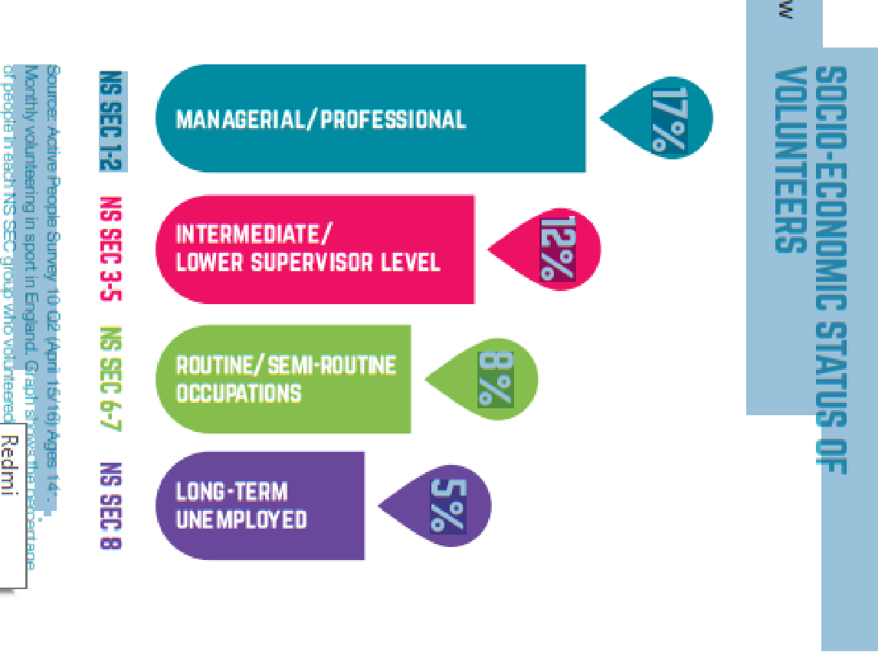
Kes teeb vabatahtlikku tööd ja miks?
Kanadas ja Inglismaal:
-Noored;
kõrgem sissetulek/ täiskohaga töö
väikeste lastega
mehed (kaks kolmandikku)
üle keskmise haridustase.
Notes:
The demographics of sport volunteers in sport clubs suggest that the majority of them come from higher socio-economic groups are maleof younger age, in either full time employment with young children and a higher education level Volunteers come from a variety of backgrounds: some are (ex-)players who wish to pass on the experiences that they received after their playing career has ended; some are parents supporting their children’s involvement; and others are individuals helping their local community (Cuskelly et al. 2006a).
Make a contribution to their community
Opportunity to use their skills
Support a cause in which they believe
Know someone who needs help
Because their friends are volunteers
Good for CV
Because they have to volunteer (a condition of their children’s membership of a club)
These studies reveal a strong link between higher socio-economic groups / education / earnings and participation and volunteering
Men more likely than women to participate* (43% vs 36%) and to volunteer
Sport participation decreases with age
Our UK experts observed that the “unemployed” do not volunteer – except for young or involuntary retirees
Some social groups are underrepresented in sports volunteering-Why?
Lack of awareness of volunteering opportunities
Attitudes towards people from underrepresented groups a barrier to them engaging in volunteering
volunteering opportunities offered may not meet volunteers’ motivations
Lack of planning of volunteering opportunities
Lack of supportive/accessible volunteering environments

Slide 17
Kes teeb vabatahtlikku tööd ja miks? Schulz et al ( 2011)
Tasustamata töö või teenus:
Aktivism
Tõsine huvitegevus
Notes:
Volunteering can be thought of as three overlapping types: unpaid work or service, activism, and serious leisure (Billis 1993; Rochester 2006). This can be related both to how volunteers think of themselves, and to how managers think of volunteers.
Unpaid work or service: an economic view; filling the gaps in the market/public provision; element of altruism. HRM therefore focuses on devising (non-financial) rewards for volunteers and assumes that volunteers expect to be treated in same way as paid staff
Activism: prompted by shared values or common cause (e.g. disability sport, youth sport). HRM style and practice needs to be consistent with the organisation’s and the volunteer’s values. Volunteers get involved in order to support a cause in which they believe in or because are prompted by shared valuesPersonally affected by cause organization supports
Serious leisure: volunteering as the pursuit of a hobby/passion; these volunteers are extremely loyal; may resist change; expect to be consulted
Altruistic – pursuit of a better society
Conformist – associates do so
Personal growth
Ways to use free time
Avoid burn-out by providing:clear information on nature and purpose of volunteer work a realistic perspective
training to strengthen skills
Sources: Burnout Among Volunteers in the Social Services: The impact of Gender and Employment Status, Kulik L, 2006, Journal of Community Psychology, 35 (5) 541-561 / Basic and Applied Social Psychology, 27(4), 337 – 344
Motivations to Volunteer: Immigrant versus Canadian born percentages % Immigrants % Canadian-born Helping cause in which you believe 93 95 Use your skills and experiences 76 82 Personally affected by cause organization supports 67 69 Explore your own strengths 54 58 Fulfill your religious obligations 35 25 Because your friends volunteer 28 30 Improve your job opportunities 17 24 Required to volunteer by school * 8

Slide 18
Vabatahtlikkuse tüübid
Spordialaliidud ja klubid (Inglismaal):
100.000 spordiklubi Inglismaal
37% vabatahtlikke tuleb 3-lt spordialalt (Rugbi, kriket ja ... ?)
Mida me näeme siin?
Spordiala olemus sageli mõjutab vabatahtlike arvu vajadust (nt. jalgpall – squash)
Notes:
football
THEY ARE ALL TEAM SPORTS
Football is one of the most popular sports in the UK with a wider participation rate.Only in Kent there are approximately 850 grassroots football clubs wih approximately 20000 participants. This shows the scale of the sport and it provides a rationale why football needs more volunteers to run the clubs compared to non-popular/ non-olympic sports such as squash which does not require a large number of volunteers as there is a limited participation range and the facilities competitions are fairly easy to organise

Slide 19
Vabatahtlikkuse tüübid – Suured üritused (Inglismaa)
Üritustel vabatahtlikuks olemine on väga intensiivne, sageli on rohkem vabatahtlikke kui võistlejaid (Ujumise EM Sheffieldis 1993 – 700 vabatahtlikku, kes töötasid keskmiselt 8 tundi päevas 17 päeva jooksul)
2002 Rahvaste ühenduse Mängud – 13 000 vabatahtliku (Manchester)
1991 Universiaad – 2000 vabatahtliku (Sheffield)
Londoni 2012 Olümpiamängud – 70 000 vabatahtliku
Notes:
In contrast, sport events account for much lower figures which is suggestive of their one-off occurrence.
Mega events delivery is very demanding are often demanded in out of hours times – evenings/weekends
Major events may increase staffing by 1000 times and then reduce very quickly
he viability of many sport events, either large or small, generally depends on the short-term or episodic volunteer. Not only is the involvement of these volunteers critical to underwriting the financial and logistical success of events but event volunteers are amongst the more conspicuous components of an event and are likely to have frequent interactions with participants and/or spectators (Auld et al. 2009). Therefore, stakeholder perceptions of event quality and success may be partially dependent on the nature of their experiences with event volunteers. Despite this apparent importance and while event volunteers feature prominently in the pre- event legacy rhetoric, this interest fades somewhat rapidly once the event is over (Auld et al. 2009).
Flexible contracts:
Part-time
Seasonal
Internal flexibility
Short term
What are the advantages and disadvantages of this?

Slide 20
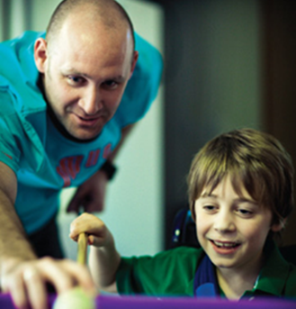
Vabatahtlikkuse tüübid – Para-spordialad
Sageli väga madal vabatahtlike ja võistlejate arvu vahekord mõnel spordialal nagu para-ratsutamine.
Keskmine vahekord on 1:5 (nt. para-ratsutamine)
14% Inglismaa rahvastikust omab puuet, kuid ainult 6% nendest teeb vabatahtlikku tööd. Miks?
Notes:
Despite the large numbers of volunteers in most sports, this is not the case for disability sports which suffer from a lack of volunteers to support their services. There is a very low ratio of volunteers to participants.an average of 1 to 5 participants in some sports for example disabled horse riding
Why do you think is that?limited media representation of disability sports- sense of altruism
14 per cent of the British population has a disability, only 6 per cent of volunteers have disabilities. That same study found that most organizations indicated problems of access and attitude/acceptance as reasons why the participation by volunteers with disabilities was low (www.cybervpm.com). While similar statistics are not available for Canada, anecdotal evidence suggests a similar trend. When persons with disabilities are involved as volunteers, it is often assumed that they want to be involved in ‘their’ causes—for example, it might be taken for granted that a person who is blind would be likely to volunteer with an organization serving the blind community. Some people may indeed prefer to work as volunteers on issues of particular personal relevance to them. For others, however, evidence suggests that they may be working on ‘their’ issues because they experience barriers to volunteering elsewhere. There may be a perception that all volunteers who use wheelchairs should want to volunteer to improve building accessibility or otherwise enhance quality of life for persons with mobility disabilities such as their own. Of course, this is not true. Just as not all women want to do volunteer work related to women’s issues, and not everyone from a given ethnic community wants to work on cultural issues, not all persons with disabilities want to volunteer with the groups that serve their needs directly. With over 178,000 charities and not-for-profit organizations in Canada, there is a multitude of issues on which persons with disabilities can volunteer.
it need not be an overwhelming task to involve persons with disabilities as volunteers. It involves taking an honest look at your current accessibility and diversity, and systematically eliminating barriers to participation. In doing so, you’ll find your whole organization becomes more accessible. For example, by installing a wheelchair ramp so that volunteers who have a physical disability can enter, you’ve just increased your accessibility to potential staff and clients, as well. You’ve also made a positive statement about your commitment to serving the community. Take one step at a time; don’t feel you need to have all the answers before putting these suggestions into practice. The most important requirements are flexibility, a positive attitude, and the organization’s commitment to involve and support persons with disabilities in our volunteer programs (Pyle, 1997)
Disability Those with a disability or limiting, long-term illness are less likely to volunteer than those who do not. In 2005, 65% of those without a disability volunteered at least once a year and 42% did so regularly, while 42% of those with a disability or limiting, long-term illness did so at least annually and 28% did so regularly (Low, Butt et al., 2007). By 2015, and with new survey methodology, the Community Life Survey found that 36% of those with a disability or limiting, long-term illness volunteered at least once a year compared to 44% of those without (Cabinet Office, 2015). In sport, the APS survey finds that 12.5% of adults without a disability or limiting, long-term illness volunteered in sport in 2012–13 compared to 9.16% of adults who do have a disability or limiting, long-term illness.

Slide 21
Googelda ”sports newspaper UK” kuupäevaga 25.02.2019 Tee esimene otsingutulemus lahti.
Mida panete tähele?
ACTIVITY
Notes:
ACTIVITY: think about the four aspects of Communication with the target groups.

Slide 22
Dream Crazier-Nike

Slide 23
Kuidas erinevad vabatahtlike motivatsioonid tehes vabatahtliku tööd spordiüritustel või spordiklubides?
Miks sa arvad, et see nii on?
DISCUSSION
Notes:
ACTIVITY: think about the four aspects of Communication with the target groups.

Slide 24
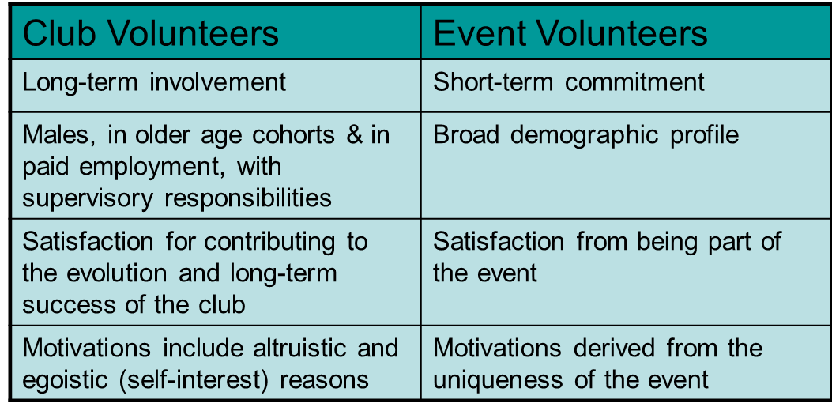
Kas ürituste vabatahtlikud on teistmoodi?
Rohkem instrumentaalsemad kui altruistlikud või vähemalt saavad oma töö eest õiglase vastutasu.
Altruism võib ajapikku muutuda tähtsamaks.
See, kas ürituste vabatahtlikest saavad pikaajalised vabatahtlikud sõltub ürituse korraldajate kvaliteedist.
Notes:
The sport volunteering literature suggests that volunteers involved in clubs or events have different characteristics, driving forces and behaviour which depends on their actual volunteering experience. For instance, club volunteers tend to reflect the participant profile of the sports concerned.However, the larger the event the broader their demographic profile..One important feature of the literature on volunteering motivations is the possibility that motivations may change over time and across settings (Slaughter, 2002). For instance, it is argued that long-term volunteers are more likely to volunteer in order to give something back to the community rather than to experience being part of a unique event, or the seeking of social interaction and networking (Cuskelly et al. 2006). The latter reasons might be much more likely at a sports event given its relatively unique nature. Thus, as Cuskelly et al. (2002) identifies, experiences may influence volunteers’ levels of commitment to an organization or a voluntary cause. It is argued that this issue needs to be considered more closely by researchers, in order to evaluate the impact of such changes in time and context on future volunteering behaviour (Bang et al, 2009).Same people but different way to exhibit their behaviour. They have different motives and seek satisfaction from other factors.
The nature of, as well as involvement in the event appear to be important antecedent factors that inﬂuence event volunteer satisfaction (Elstad 1997; Farrell et al.1998; Kemp 2002). Other factors include the opportunity to develop networks, experience feelings of job competence, recognition and the nature and amount of communication between volunteers (Elstad 1997; Farrell et al. 1998). Moreover, a number of authors have emphasized the importance of eﬀective management to volunteer satisfaction

Slide 25
Personalijuhtimine ürituste vabatahtlikkuses
Ürituste vabatahtlike on raskem hallata, sest vähem rahulolu faktoreid on juhtide kontrolli all.
Juhatajad sageli kaasavad rohkem vabatahtlike, kui vaja ja seega võivad vabatahtlikud tunda, et nende panus on vähem väärtuslik.
Notes:
Therefore, event managers should concentrate their e ﬀ orts to increase event volunteer satisfaction on those event elements over which they have some degree of control, especially the nature of the work itself and management practices such as: communication; matching roles and expectations; mentoring; and, workloads and rosters. These issues are likely to be especially critical in the event context due to the elevated levels of work pressure associated with in ﬂ exible deadlines and the overall highly stressful nature of event management. E ﬀective event volunteer management does not just focus on the event implementation phase but begins with the pre-recruitment and orientation phases and extends right through to the post-event (and between events) periods. Thus event managers need to adopt an ‘event volunteer lifecycle’ approach to ensuring their volunteers are managed in a manner conducive to inﬂuencing satisfaction, commitment and retention. Furthermore, although the external factors ‘unique’ to the nature of the event itself are important, as argued by Cuskelly et al. (2004) and Rundle-Thiele and Auld (2009), managers should not ignore the intrinsic appeal of event volunteering and hence the importance of good management practices. Consequently, man- agers should focus on enhancing the feelings by event volunteers that they: have the freedom to use their skills; can develop their skills further if required through e ﬀective orientation and training opportunities; are able to make a meaningful contribution; can interact with other volunteers, participants and spectators; and, are highly valued for their contributions.

Slide 26
Mis takistab inimestel vabatahtliku tööd tegemast?
Aja puudumine (83%) Tegelik ja tajutud pühendumise vajaduse taju.
Bürokraatia (49%) Paberitöö ja muutumine nagu palgaliseks tööks; vastutus; protsesside formaliseerumine.
Riskid (47%) “Kompensatsiooni kultuur”; kartus, et keegi kaebab neid kohtusse.
Informatsiooni puudumine (39%) Ei kutsuta vabatahtlikuks või ei tea, kust leida infot vabatahtliku töö võimaluste kohta.

Slide 27
Vabatahtlikud spordiorganisatsioonid
Ühised jooned:
vastutavad hääletavate liikmete eest
juhitud valitud juhatuse poolt
juhitakse põhikirja alusel
Notes:
Have 3 common featuresThey are membership based organizations and therefore they are responsible to satisfy their members interests. They are managed by an elected board which normally comes from their membership base and they are nominated by the members and they are governed by a constitution. So that means they have a clear policy and strategy to implement and a clear organizational culture. With the term culture we refer to the values that our organization and its members aim to represent. For example, if the organization and its members value sports free of performance enhancing drugs use sport then they promote drug testing of their athletes.
For many voluntary positions in sport organizations the recruitment process is somewhat different.It is typically informal (through friends, family or individuals already involved in the organization) and attracting a sufficient number of qualified applicants is difficult. In some other non-profit sport voluntary positions such as board members may be elected or appointed on an exofficio basis.In the latter situation recruitment is via nomination and selection via election when recruiting volunteers is important to emphasise the benefits to the volunteer rather than the organization.Volunteers should be recognised and valued and not feel as though being recruited for a position that noone else would want to do or that they are not being paid just to save the organizations money

Slide 28
Mitteametlikud protsessid
Juhatuse liikmed kandideerivad läbi nominatsioonide ja valitakse hääletusega.
Notes:
For many voluntary positions in sport organizations the recruitment process is somewhat different.It is typically informal (through friends, family or individuals already involved in the organization) and attracting a sufficient number of qualified applicants is difficult. In some other non-profit sport voluntary positions such as board members may be elected or appointed on an exofficio basis.In the latter situation recruitment is via nomination and selection via election when recruiting volunteers is important to emphasise the benefits to the volunteer rather than the organization.Volunteers should be recognised and valued and not feel as though being recruited for a position that noone else would want to do or that they are not being paid just to save the organizations money

Slide 29
Kes teeb spordis vabatahtliku tööd ja miks?
94 miljonit täiskasvanut (23%) on EL-is seotud vabatahtliku tööga.
Kus?
- Suur toetumine vabatahtlikele enamustes liikmesriikides (nt. Austrias 14% palgalisi töölisi ja 86% vabatahtlike; Taanis (31.5%), Inglismaal (26%), Prantsusmaal (25%) ja Maltal (84%). Prantsusmaal peaaegu 80% vabatahtlike; Hollandis 13% palgalisi töölisi ja 87% vabatahtlike).
Kes?
Enamustes EL-i riikides: vanuses 30-50; kõrgem sissetulek/ täisajaga töökoht; väikeste lastega; meessoost (kaks kolmandikku); keskmisest kõrgem haridustase.
Miks?
tasustamata töö või teenus:
Aktivism
tõsine hobi (Schulz et al.,2011)

Slide 30
Kas vabatahtliku töö kasu on jaotunud üle kogu kogukonna või on need kontsentreeritud jättes mõned paigad kogukonnas sotsiaalselt hüljatuna? Mis sa arvad, miks see nii on?
Mõtle oma organisatsiooni peale: kes on teie tavaline vabatahtlik? Kas nad on kindlas vanuses, soost, rahvusliku taustaga või sotsiaal-majanduslikust taustast? Siis vaata oma kogukonda. Milliseid osi kogukonnast kaasate vabatahtlikena? Või veel tähtsam - kes on puudu? Mis takistused hoiavad ära kõikide võrdset osalemist vabatahtlikus töös? Kuidas teha vabatahtlik töö rohkem kaasavaks?
Notes:
ACTIVITY: think about the four aspects of Communication with the target groups.

Slide 31
Vabatahtlikuse väljakutsed ja sotsiaalne kaasatus
Mõned sotsiaalsed grupid on ala-esindatud spordi vabatahtlike hulgas - Miks?
Info puudumine vabatahtliku töö võimaluste kohta.
Suhtumine ala-esindatud gruppidesse on neile takistuseks olla kaasatud vabatahtlikku töösse.
Pakutavad võimalused vabatahtlikuks tööks ei pruugi vastata vabatahtlike motivatsioonidele.
Puudulik vabatahtlikkuse võimaluste planeerimine.
Puudulikud vabatahtlikkuse keskkonnad, mis on toetavad/kättesaadavad.

Slide 32
Pane kirja soovitusi kohalikule spordiklubile, kuidas nad saaksid kaasata vabatahtlike ala-esindatud gruppidest. Premeeri neid. Hoia neid vabatahtlikena läbi koolituste ja arenduse. Kasuta oma isiklikke kogemusi, et anda sisendit oma soovitustele.
Notes:
ACTIVITY: think about the four aspects of Communication with the target groups.

Slide 33
Head praktikad
STRENGHTENING COACHING WITH THE OBJECTIVE TO RAISE EQUALITY – SCORE (Tugevdada treenereid eesmärgiga tõsta kvaliteeti -SCORE) Edendaja: European Non‐Governmental Sports Organisation (ENGSO), läbiviidud: 2015‐2016.
SCORE, EL-i rahastatud projekt, mille fookus on tõsta nii naissoost palgatud ja vabatahtlike treenerite arvu kui ka soolist teadlikust treenerite koolitustel.
Selle projekti sihtgrupiks olid spordi ja treenerite organisatsioonid kõigil tasemetel koos treenerite, endiste sportlaste, vabatahtlike ja otsustajatega treenerite valdkonnas.
SCORE projekti raames töötati välja nii programm mentoritele kui ka hariduslik töövahend.

Slide 34
Järeldused
Mitmekesine vabatahtlike meeskond mitmekesiste vajaduste ja motivatsioonidega.
On äärmiselt oluline tunnustada ja hinnata vabatahtlike panust.
Spordisektori olemus on, et see on kõigile - Vabatahtlik töö peaks seega olema kaasav ja avatud kõigile.
Sobitada vabatahtlike oskused ja motivatsioonid olemasolevate võimalustega.
Formaalsemad personalijuhtimise protsessid on vajalikud.

Slide 35
Kasutatud kirjandus
Bryman, A. (2006). Integrating quantitative and qualitative research: How is it done? Qualitative Research, 6(1), 97-113. doi: 10.1177/1468794106058877
DCMS. (2007). Our Promise for 2012: How the UK will benefit from the Olympic and Paralympic Games. London: Department for Culture, Media and Sport. DCMS. (2012). Beyond 2012: the London 2012 legacy story http://www.culture.gov.uk/images/publications/DCMS_Beyond_201 2_Legacy_Story.pdf
Dickson, T. J., Benson, A. M., Blackman, D. A., & Terwiel, A. F. (2013). It's All About the Games! 2010 Vancouver Olympic and Paralympic Winter Games Volunteers. Event Management, 17(1), 77-92
LOCOG. (2009). Get involved: The Volunteer Programme - London 2012. The official site of the London 2012 Olympic and Paralympic Games http://www.london2012.com/get-involved/volunteering/thevolunteer-programme.php
LOCOG (2013). Legacy assured for London 2012 Database http://www.london2012.com/news/articles/legacy-assured-forlondon-2012-database.html?cid=rss
Nichols, G and Ralston, R (2014) The legacy costs of delivering the 2012 Olympic and Paralympic Games through regulatory capitalism. Leisure Studies http://www.tandfonline.com/doi/full/10.1080/02614367.2014.923495.
Nichols, G and Ralston, R (2014) The 2012 Ambassadors: – second class Nichols, G and Ralston, R (2012) Lessons from the Volunteering Legacy of the 2002 Commonwealth Games. Urban Studies. Volume 49 Issue 1 January 2012 pp. 165 - 180.
Nichols, G and Ralston, R (2011) Social inclusion through volunteering – a potential legacy of the 2012 Olympic Games. Sociology. 45 (5) pp. 900-914.
Nichols, G and Ralston, R (2011) Manchester Event Volunteers: a legacy and a role model. University of Sheffield and Manchester Metropolitan University. http://www.shef.ac.uk/polopoly_fs/1.227269!/file/MEV_2012_with_cover.pdf

Slide 36
Aitäh osalemast!

